Slide 1

COMP-SCI 5590 - 0003 Special Topics
Mobile App development

Slide 2
Agenda
Calendar API
Publishing apps to Google Play Store

Slide 3
Calendar API
Calendar API is available as of Android 4.0
used for displaying and selecting dates.
The supported range of dates of this calendar is configurable.
User can select a date by taping/clicking on it and also can scroll & find the calendar to a desired date. Developer can also set minimum and maximum date shown in calendar view.

Slide 4
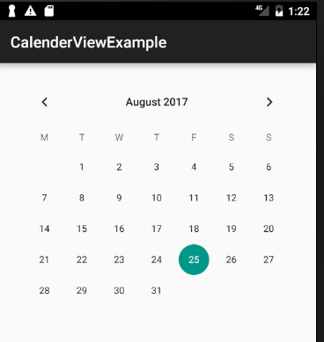
Basic Calendar View XML Code
<CalendarView
android:id="@+id/simpleCalendarView"
android:layout_width="fill_parent"
android:layout_height="fill_parent" />

Slide 5
Attributes of Calendar
id: id attribute is used to uniquely identify a CalendarView.
firstDayOfWeek: This attributes is used to set the first day of week according to Calendar. We can also set this programmatically means in java class using setFirstDayOfWeek(int firstDayOfWeek) method
focusedMonthDateColor: This attribute is used to set the color for the dates of the focused month. We can also set this programmatically means in java class using setFocusedMonthDateColor(int color) method.
unfocusedMonthDateColor: This attribute is used to set the color for the dates of the unfocused month. We can also set this programmatically means in java class using setUnfocusedMonthDateColor(int color) method
maxDate: This attribute is used to set the maximal date supported by this CalendarView. This attribute use mm/dd/yyyy format. We can also set this programmatically means in java class using setMaxDate(long maxDate)
minDate: This attribute is used to set the minimal date supported by this CalendarView. This attribute use mm/dd/yyyy format. We can also set this programmatically means in java class using setMinDate(long minDate)

Slide 6
Attributes of Calendar
selectedDateVerticalBar: This attribute is used to set the drawable/color for the vertical bar shown at the beginning and at the end of the selected date. We can also set this programmatically means in java class using setSelectedDateVerticalBar(int resourceId) or setSelectedDateVerticalBar(Drawable drawable) method.
selectedWeekBackgroundColor: This attribute is used to set the color in the background of selected week of CalendarView. We can also set this programmatically in java class using setSelectedWeekBackgroundColor(int color) method.
showWeekNumber: This attribute is used to show or hide the week number of CalendarView. In this method we set Boolean type value means true or false. We can also set this programmatically means in java class using setShowWeekNumber(boolean showWeekNumber) method.
weekNumberColor: This attribute is used to set the color for the week numbers.
weekSeparatorLineColor: This attribute is used to set the color for the week separator line. We can also set this programmatically means in java class using setWeekSeparatorLineColor(int color) method.

Slide 7
Important Methods Of Calendar View
getDate(): This method is used to get the selected date of CalendarView in milliseconds since January 1, 1970 00:00:00 in user’s preferred time zone. This method returns long type value for selected date.
setDate(long date): This method is used to set the selected date in milliseconds since January 1, 1970 00:00:00 in user’s preferred time zone.
setFirstDayOfWeek(int firstDayOfWeek): This method is used to set the first day of the week.
getFirstDayOfWeek(): This method is used to get the first day of week. This method returns an int type value.
setMaxDate(long maxDate): This method is used to set the maximal date supported by thisCalendarView in milliseconds since January 1, 1970 00:00:00 in user’s preferred time zone.
getMaxDate(): This method is used to get the maximal date supported by this CalendarView in milliseconds since January 1, 1970 00:00:00 in user’s preferred time zone. This method returns long type value for maximal date supported by this CalendarView.

Slide 8
Important Methods Of Calendar View
setMinDate(long minDate): This method is used to to set the minimal date supported by this CalendarView in milliseconds since January 1, 1970 00:00:00 in user’s preferred time zone.
getMinDate(): This method is used to to get the minimal date supported by thisCalendarView in milliseconds since January 1, 1970 00:00:00 in user’s preferred time zone. This method returns long type value for minimal date supported by this CalendarView.
setShowWeekNumber(boolean showWeekNumber): This method is used to show or hide the week number of CalendarView.
getShowWeekNumber(): This method is used to check whether the week number are shown or not. This method returns Boolean type value means true or false. True indicates week numbers are shown and false indicates week numbers are currently hidden.
getSelectedDateVerticalBar(): This method is used to get the drawable i.e used for the vertical bar shown at the beginning and at the end of the selected date. This method was deprecated in API level 23 so no longer used by Material style CalendarView.

Slide 9
Important Methods Of Calendar View
setSelectedDateVerticalBar(Drawabledrawable): This method is used to set the drawable for the vertical bar shown at the beginning and at the end of the selected date. This method was deprecated in API level 23 so no longer used by Material style CalendarView.
setSelectedDateVerticalBar(int resourceId): This method is used to set the color for the vertical bar shown at the beginning and at the end of the selected date. This method was deprecated in API level 23 so no longer used by Material style CalendarView.
setSelectedWeekBackgroundColor(int color): This method is used to set the color in the background of selected week of CalendarView. This method was deprecated in API level 23 so no longer used by Material style CalendarView.
getSelectedWeekBackgroundColor(): This method is used to get the background color of selected week of CalendarView. This method returns an int type value. This method was deprecated in API level 23 so no longer used by Material style CalendarView.
getWeekNumberColor(): This method is used to get the color of week numbers. This method returns an int type value. This method was deprecated in API level 23 so no longer used by Material style CalendarView.

Slide 10
Important Methods Of Calendar View
setWeekNumberColor(int color): This method is used to set the color for the week numbers. This method was deprecated in API level 23 so no longer used by Material style CalendarView.
setWeekSeparatorLineColor(int color): This method is used to set the color for the week separator line. This method was deprecated in API level 23 so no longer used by Material style CalendarView.
getWeekSeparatorLineColor(): This method is used to get the color of week separator line. This method returns an int type value. This method was deprecated in API level 23 so no longer used by Material style Calendar View.
setUnfocusedMonthDateColor(int color): This method is used to set the color for the dates of an unfocused month. This method was deprecated in API level 23 so no longer used by Material style Calendar View.
getUnfocusedMonthDateColor(): This method is used to get the color for the dates of an unfocused month. This method returns int type value. This method was deprecated in API level 23 so no longer used by Material style CalendarView.
setFocusedMonthDateColor(int color): This method is used to set the color for the dates of an focused month. This method was deprecated in API level 23 so no longer used by Material style CalendarView.

Slide 11
Important Methods Of Calendar View
getFocusedMonthDateColor(): This method is used to get the color for the dates of an focused month. This method returns int type value. This method was deprecated in API level 23 so no longer used by Material style CalendarView.
setOnDateChangeListener(OnDateChangeListenerlistener): This method is used to set the listener to be notified upon selected date change.

Slide 12
Toast class
Toast class is used to show notification for a particular interval of time. After sometime it disappears. It doesn't block the user interaction.

Slide 13
Constants of Toast Class
Constant | Description
public static final int LENGTH_LONG | displays view for the long duration of time.
public static final int LENGTH_SHORT | displays view for the short duration of time.

Slide 14
Methods of Toast class
Method | Description
public static Toast makeText(Context context, CharSequence text, int duration) | makes the toast containing text and duration.
public void show() | displays toast.
public void setMargin (float horizontalMargin, float verticalMargin) | changes the horizontal and vertical margin difference.

Slide 15
Sample Toast Code
Toast toast=Toast.makeText(getApplicationContext(),"Hello",Toast.LENGTH_SHORT);
toast.setMargin(50,50);
toast.show();

Slide 16
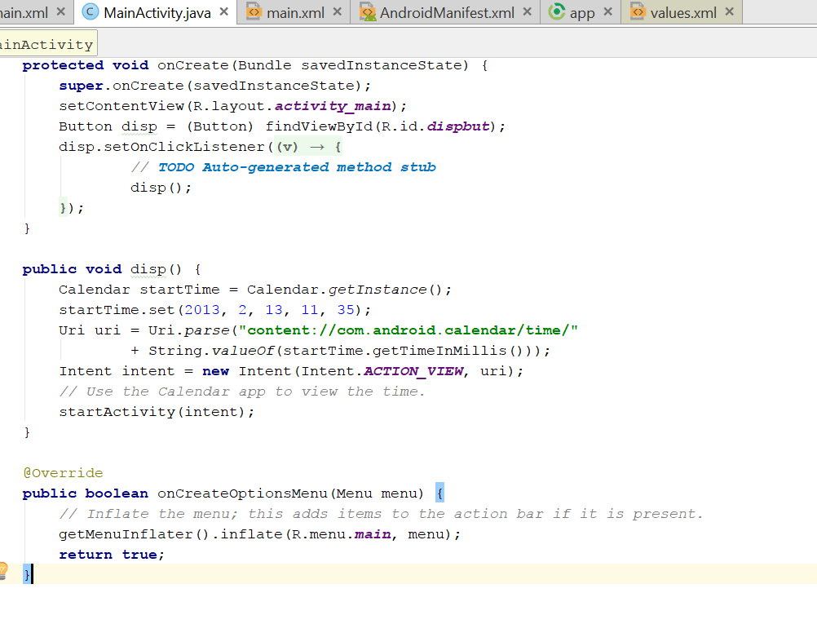
Usecase 1- display Event
Calling calendar on click using Intent

Slide 17
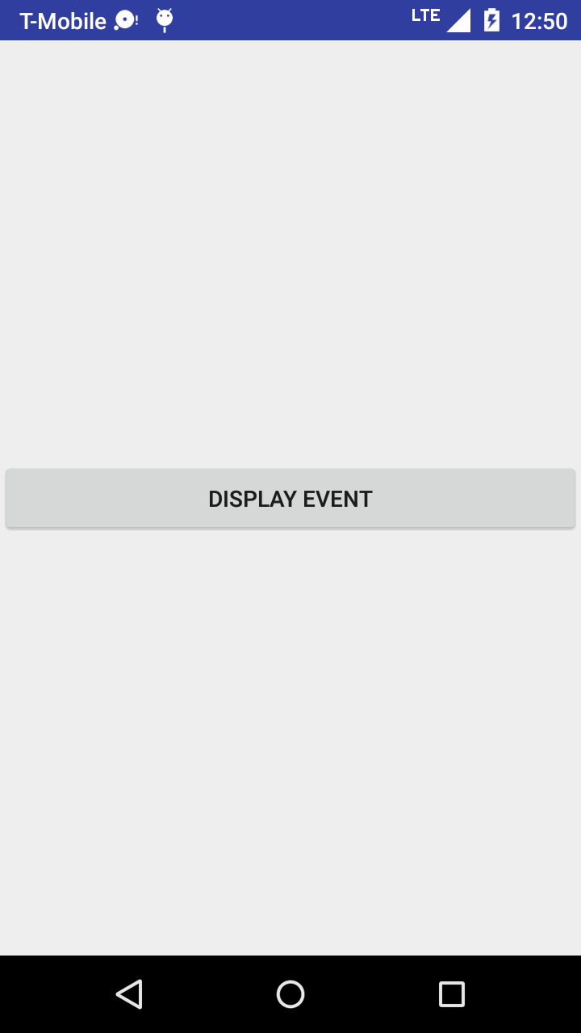
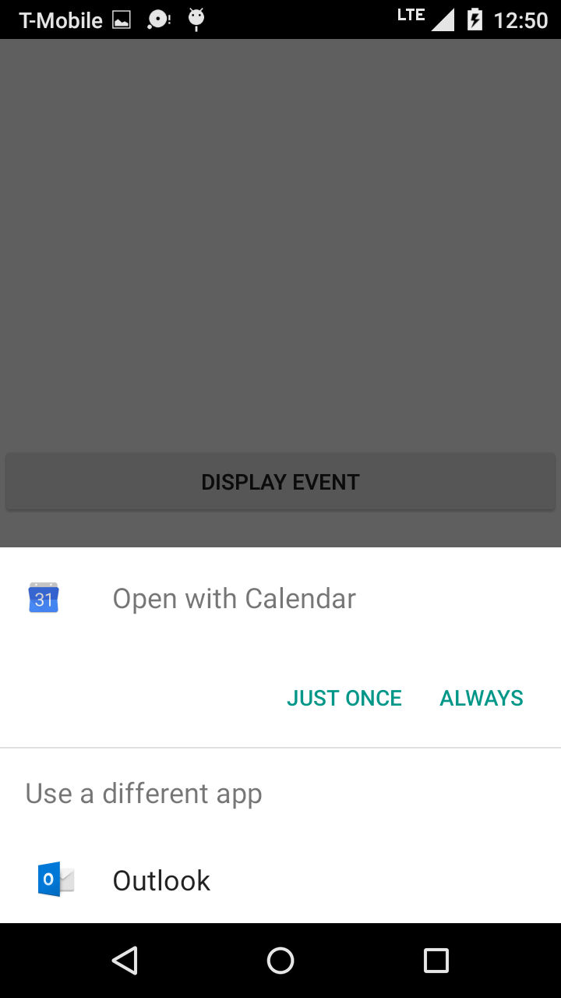
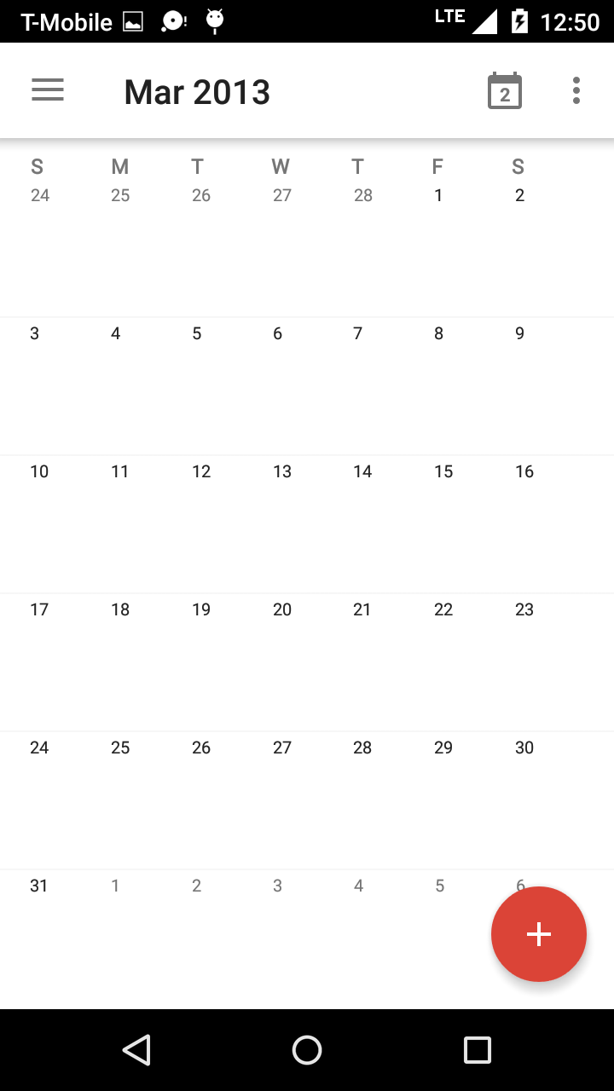
Output

Slide 18
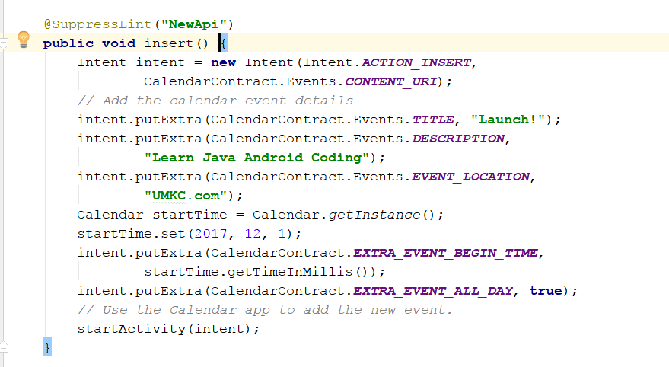
Usecase 2- Insert Event

Slide 19
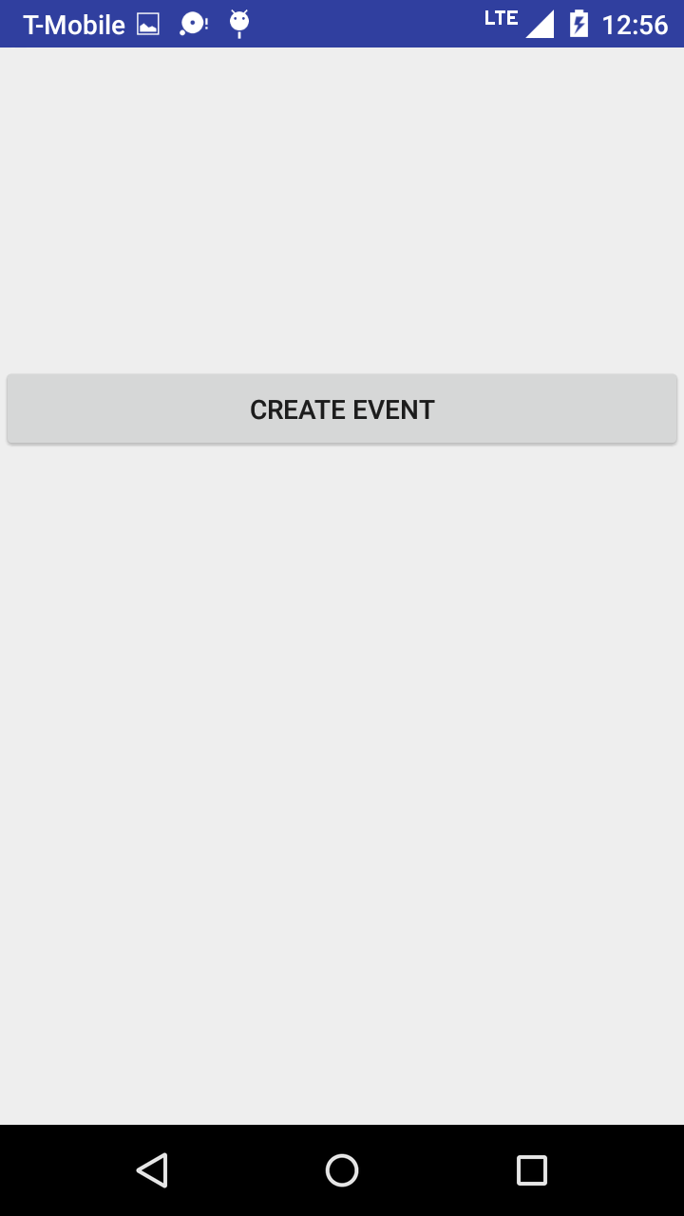
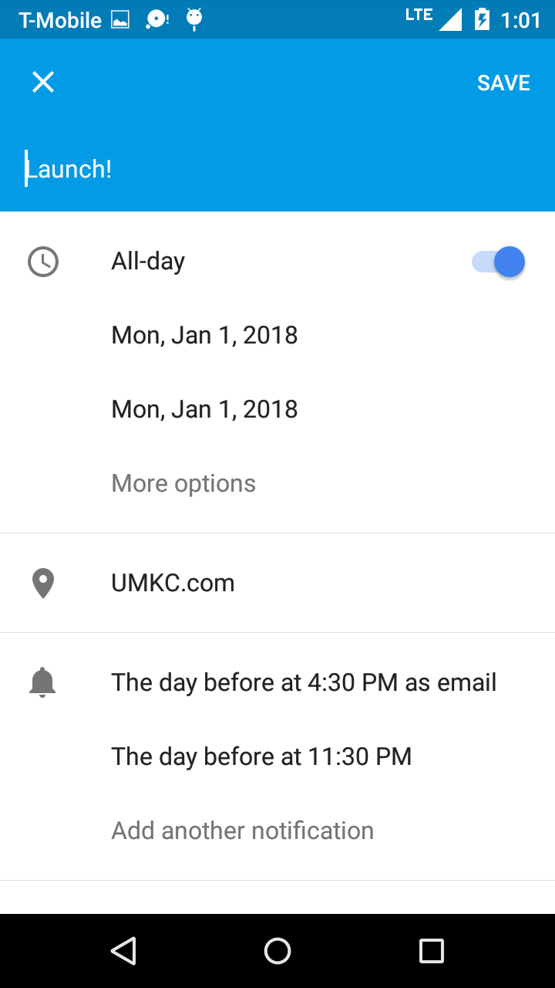
Output- Creating Event

Slide 20
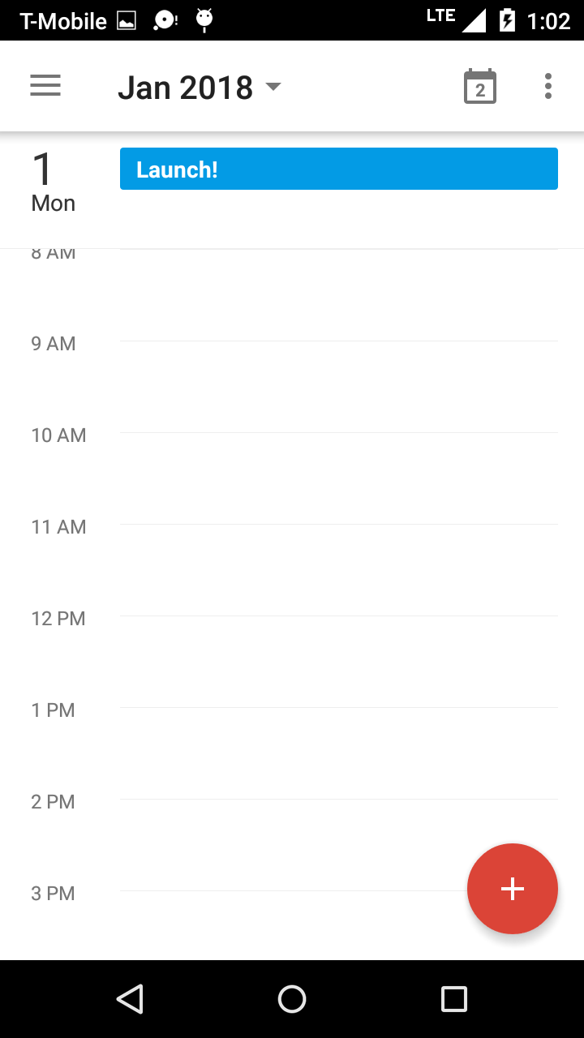
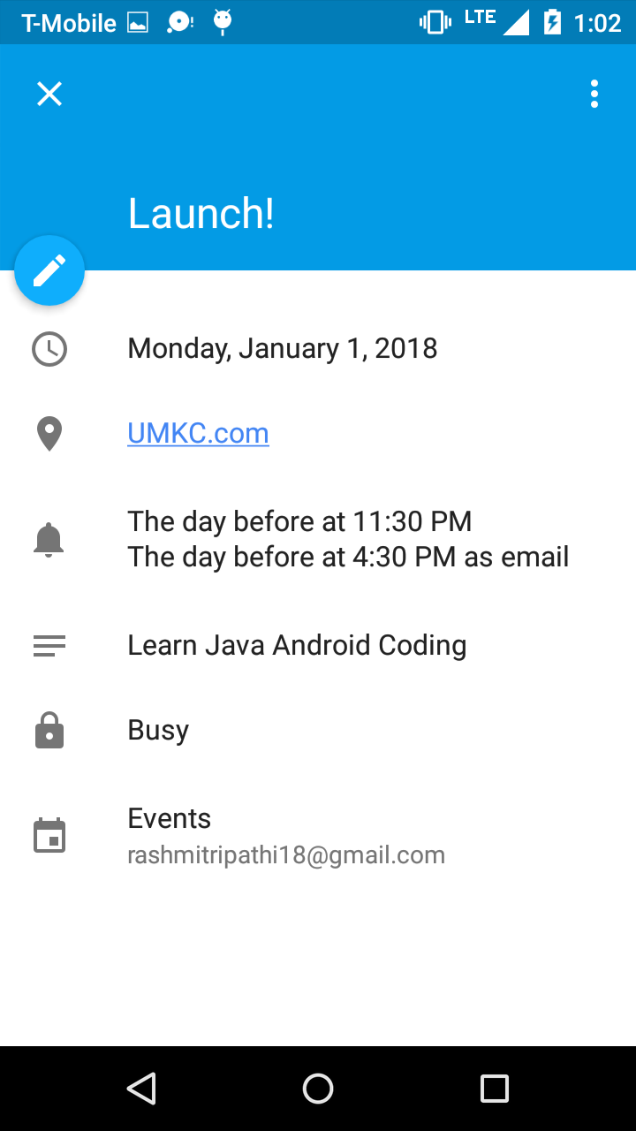
See Event Details

Slide 21
Publishing Apps
Android application publishing is a process that makes your Android applications available to users.
Apps developed are sold and distributed using Google Play store
Another way is directly sending to users using your website (least preferred as there is inbuilt cost of maintaining your host website)
You will need to export your application as an APK (Android Package) file before you upload it Google Play marketplace.

Slide 22
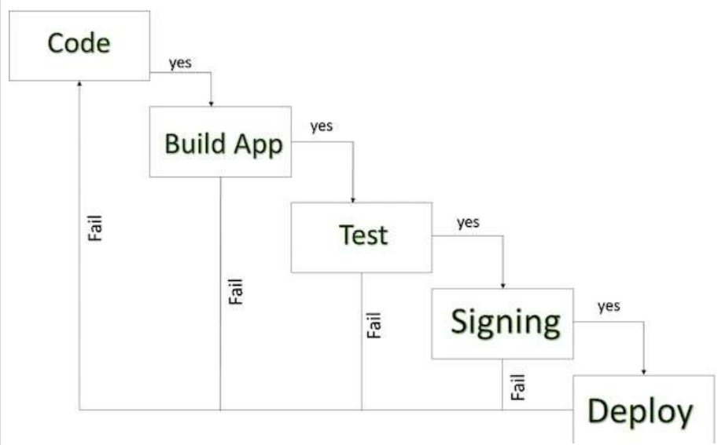
Android Development Life Cycle

Slide 23
Steps for Deployment
Regression Testing | Test on all the devices you want the target
Application Rating | When you will publish your application at Google Play, you will have to specify a content rating for your app, which informs Google Play users of its maturity level. Currently available ratings are (a) Everyone (b) Low maturity (c) Medium maturity (d) High maturity.
Targeted Regions | what countries and territories where your application will be sold. take care of setting up time zone, localization or any other specific requirement as per the targeted region.
Application Size | the maximum size for an APK published on Google Play is 50 MB. If your app exceeds that size, or if you want to offer a secondary download, you can use APK Expansion Files, which Google Play will host for free on its server infrastructure and automatically handle the download to devices.

Slide 24
Cont.
SDK and Screen Compatibility | app is designed to run properly on the Android platform versions and device screen sizes that you want to target.
Application Pricing | Deciding whether you app will be free or paid is important because, on Google Play, free app's must remain free. If you want to sell your application then you will have to specify its price in different currencies.
Promotional Content | supply a variety of high-quality graphic assets to showcase your app or brand. After you publish, these appear on your product details page, in store listings and search results, and elsewhere.

Slide 25
Cont.
Build and Upload release ready APK | The release-ready APK is what you will upload to the Developer Console and distribute to users. You can check complete detail on how to create a release-ready version of your app: Preparing for Release.
Finalize application Detail | Google Play gives you a variety of ways to promote your app and engage with users on your product details page, from colourful graphics, screen shots, and videos to localized descriptions, release details, and links to your other apps. So you can decorate your application page and provide as much as clear crisp detail you can provide.

Slide 26
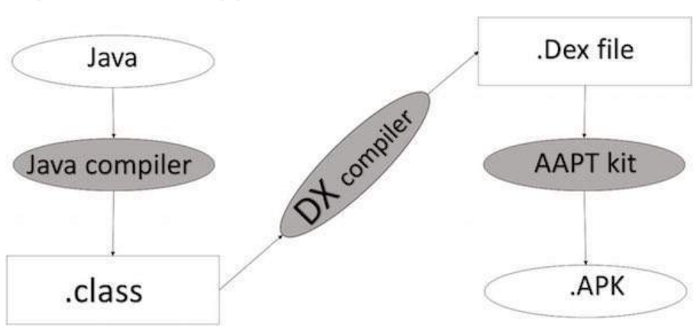
Export Android Application Process

Slide 27
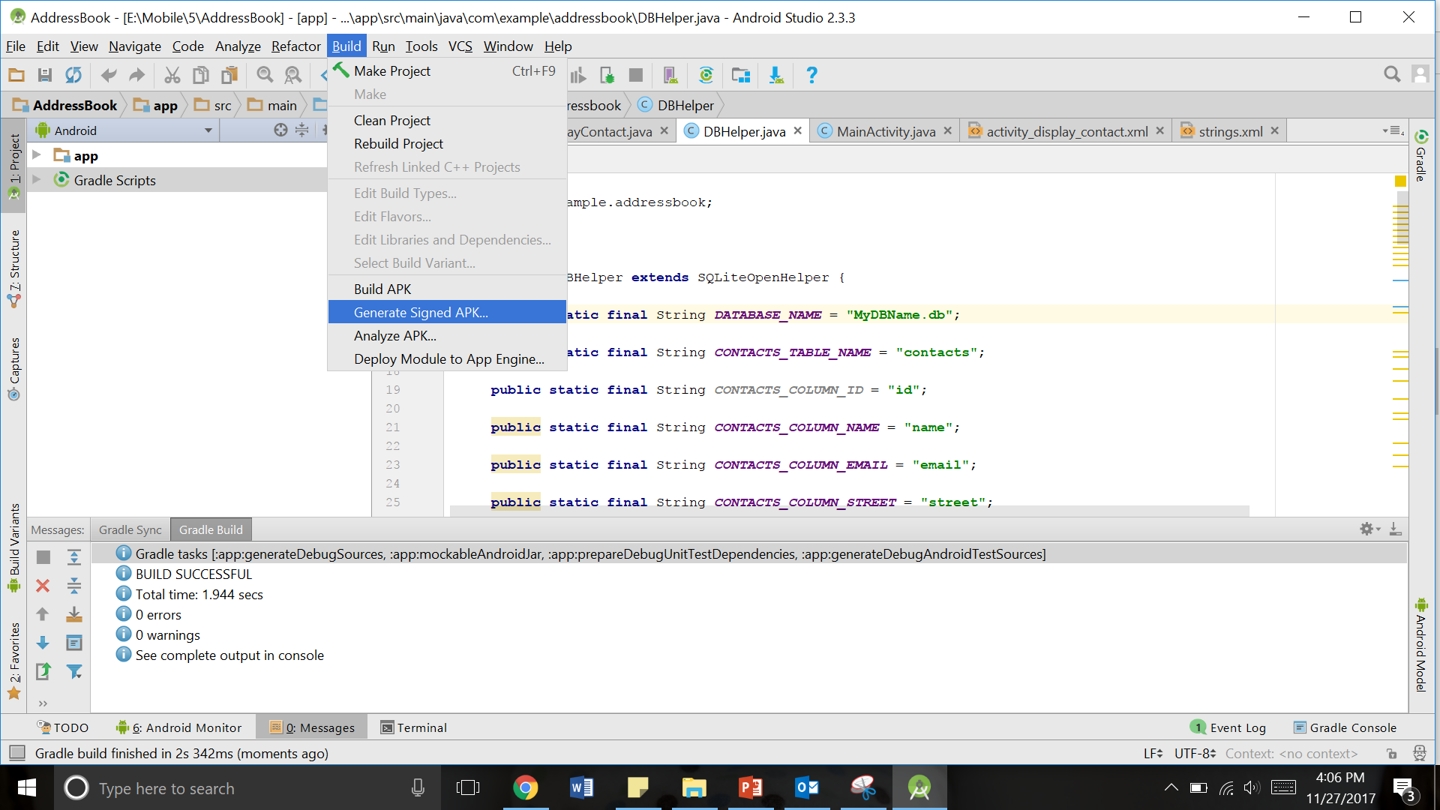
Using Android Studio
select Build → Generate Signed APK(Android Packaging Kit) from your Android studio

Slide 28
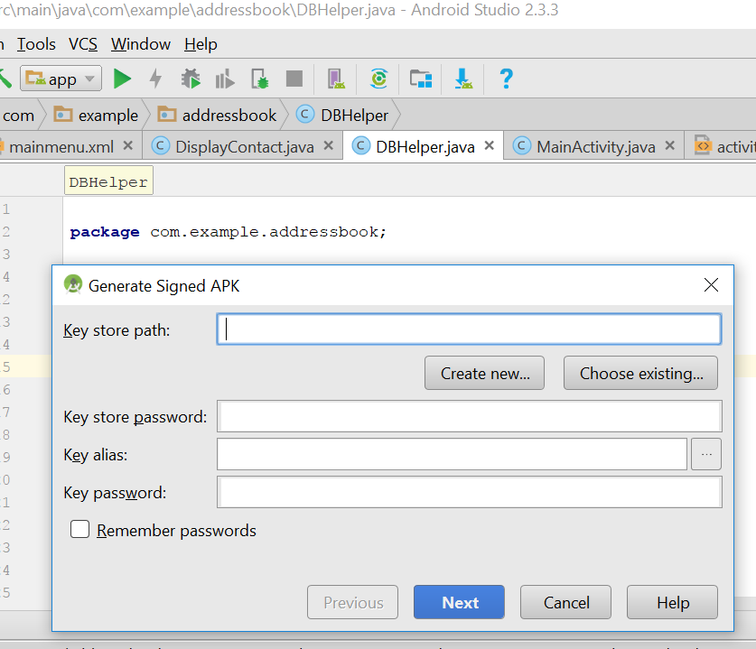
choose Create new keystore to store your application

Slide 29
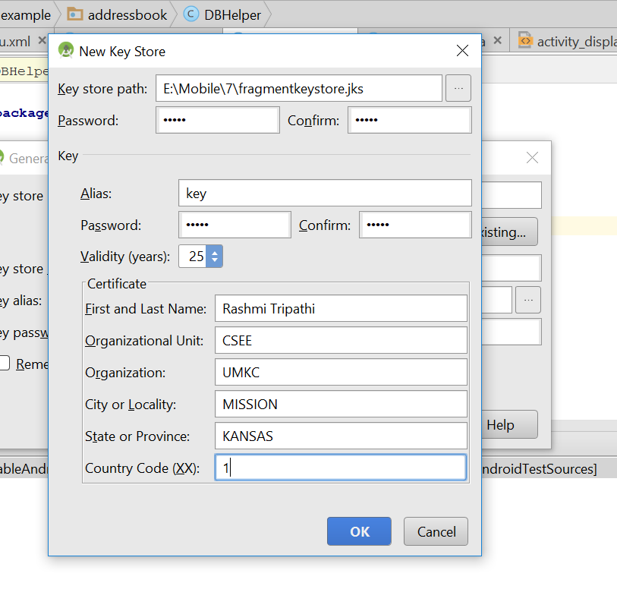
Mention all the details
Give File name for key store Path

Slide 30
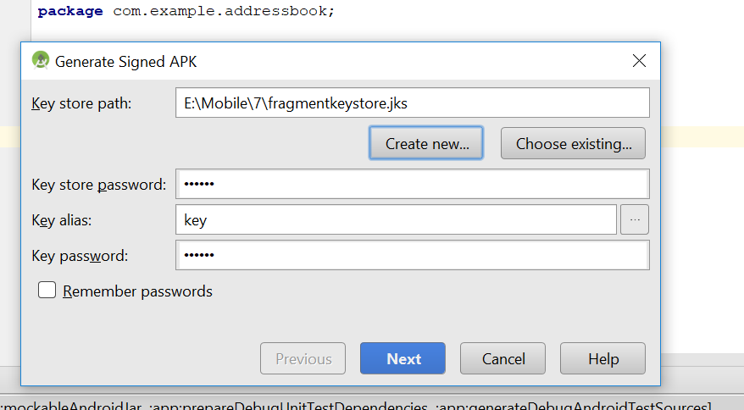
Click Next

Slide 31
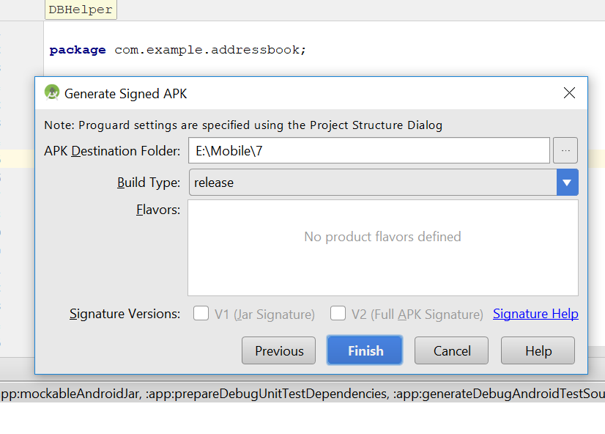
Click Finish

Slide 32
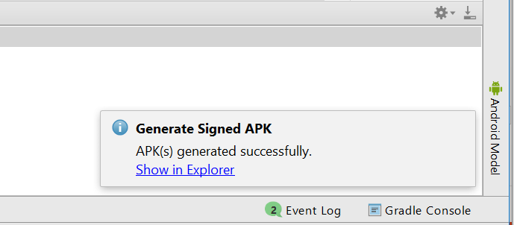
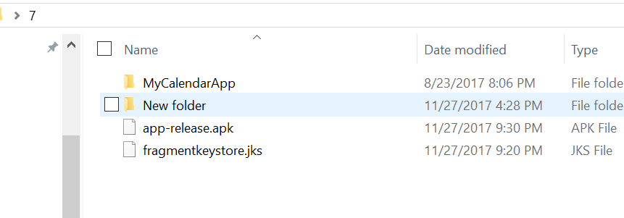
Final Result

Slide 33
Google Play Registration

Slide 34
Things Required to Publish an App
There are few things that you need to provide with your application while publishing it.
Such as:
Listing details
Store Graphics
Screenshots (Minimum 2)
Videos (Optional)

Slide 35
Listing Details
App Name :- Give suitable app name for your application.
App Description :- Write suitable description for your app, not exceeding 4000 characters.
Category :- It is required that you select an appropriate category for you application.
Application Type :- It is also required that you set a category for your application. This could be either set as application or game
Organization Name :- It is also required that you mention the name of organization while filling up the details.
Support information :- This includes URL , Email, Phone number etc.

Slide 36
Store Graphics
App Icon
512 x 512 px
32-bit PNG
Max size 1024KB
Transparency allowed
Promo graphic
180 x 120 px
24-bit PNG
No border
No Transparency
Feature graphic This is also optional but is required to get your app featured anywhere. This image has the following constraints
1024 x 500 px
safe frame of 924 x 400 px
24-bit PNG
No Transparency

Slide 37
Screenshots
Screenshots are important because people will see screenshot before installing app on phone. So it must convey your main functionality.
Constraints for the screenshots are
6 additional optional
480 x 800 px, or 480 x 854 px
72dpi, RGB, flattened
No transparency
High quality JPEG or 24-bit PNG
No borders
Can show status bar

Slide 38
Video (Optional)
Finally you can even show how your app works through a video. This can greatly increase the chances of popularity of your app as the viewer can get synopses of your application. Google recommends the length of the video to be anything between 30 seconds to 2 minutes.

Slide 39
Final Check
Apart from this you need to set some other parameters as well. Like
Size- the size of the app should not exceed 50 Mb
Pricing- you need to decide whether your app should be free or priced.
Country distribution- you get to decide which country or territories your app should be distributed.
Rating- This is the maturity rating required of your app. You can set is as everyone, low maturity, medium maturity, high maturity.
At least once you need to read Google play store policies ☺
This APK is then uploaded. This includes
Optimization
Building
signing with your release key
Final testing.
All this and you are good to go.

Slide 40

Go to the URL:
Click on the following Button:

Slide 41
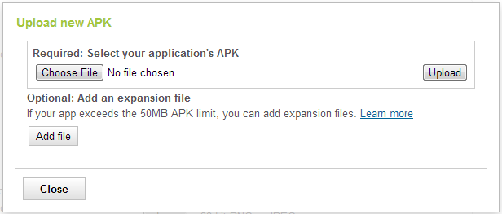
Give the path where your apk file is placed and click on upload Button:

Slide 42
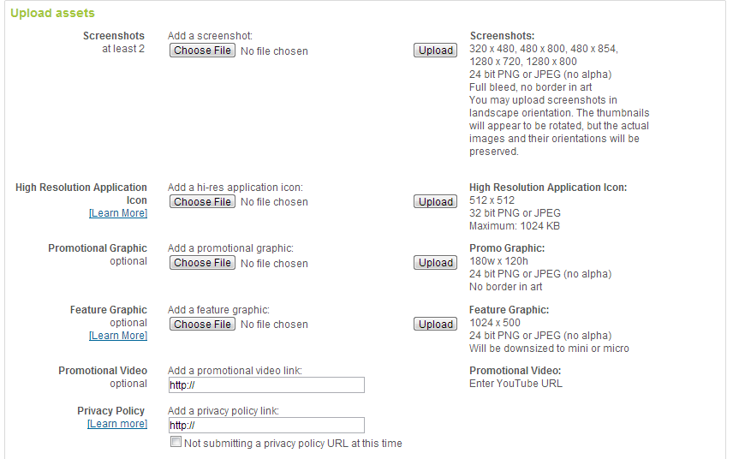
Attach assets of an Application

Slide 43
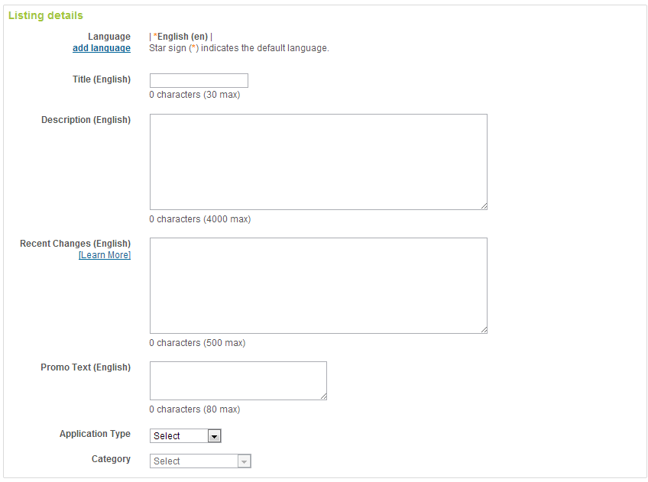
Fillup all Application Listing Details...
Part 1 of 4…

Slide 44
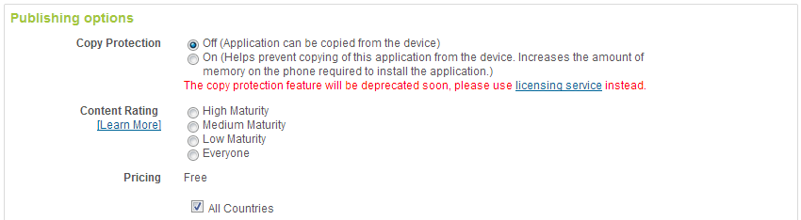
Choose the appropriate publishing options :
Part 2 of 4…

Slide 45
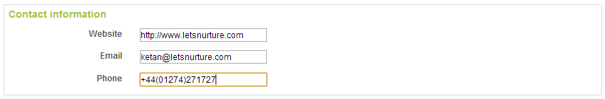
Contact Information :
Part 3 of 4…

Slide 46
At last....
Once these all processes finished, You have to accept the agreements. Finally, You can click on publish button to upload your app on play store.
Your App will be publish on market within 1-2 hours.

Slide 47
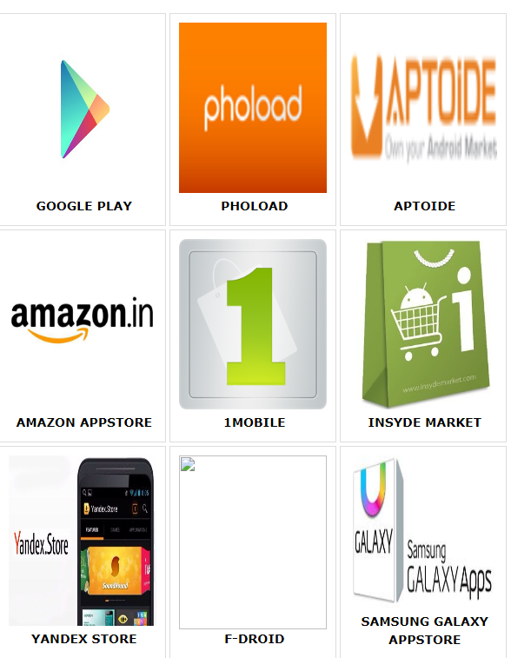
App Markets

Slide 48


Slide 49
References
https://www.slideshare.net/ravalketan/publishing-an-app-for-google-play-store
http://abhiandroid.com/ui/calendarview
https://www.youtube.com/watch?v=YWRLxgZej6s
https://www.tutorialspoint.com/android
http://www.sanfoundry.com/java-android-program-insert-new-calendar-event-intent/

